Slide 1
Neural Networks
Santosh GSK
Industry Expert

Slide 2

Artificial Neural Networks (ANN)
How does brain works?
What are the mathematical models of brain activity?

Slide 3
Neural Network
Neurons
The hypothesis that mental activity consists primarily of electrochemical activity in networks of brain cells
fires a downward signal when the input signal exceeds a threshold
Neural Network
Collection of units connected together, the properties of network are determined by its topology and the properties of neurons

Slide 4
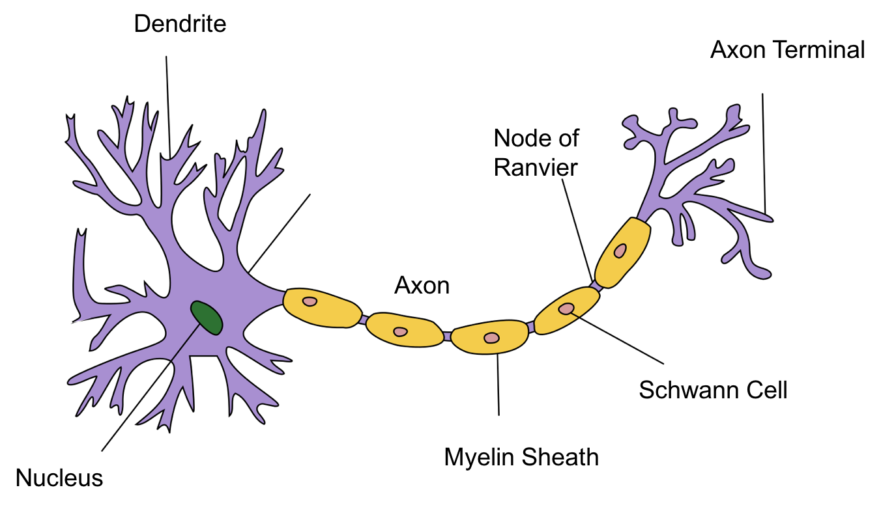
Biological Neuron

Slide 5
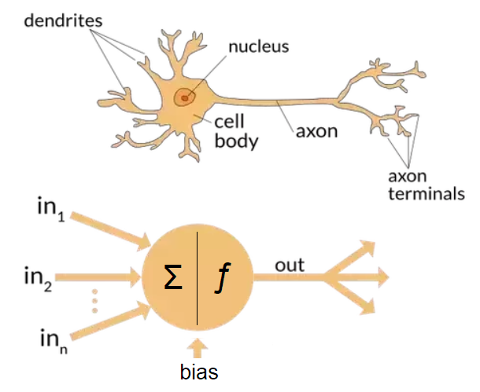
Artificial Neuron

Slide 6
ANN building blocks
Neuron Units
Basic structures of Neural Networks
Also known as artificial neurons
Receives signals, processes them and transmit
Links
Units are connected through links
Each link can transmit a signal from one artificial neuron to another
Activation
Transforms the input signal into a restricted output

Slide 7
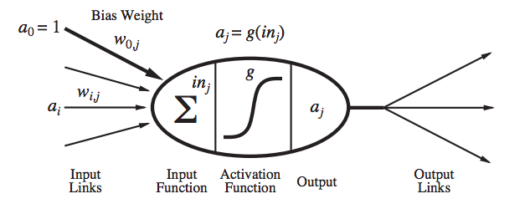
Example ANN

Slide 8
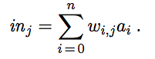
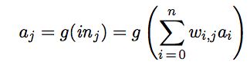
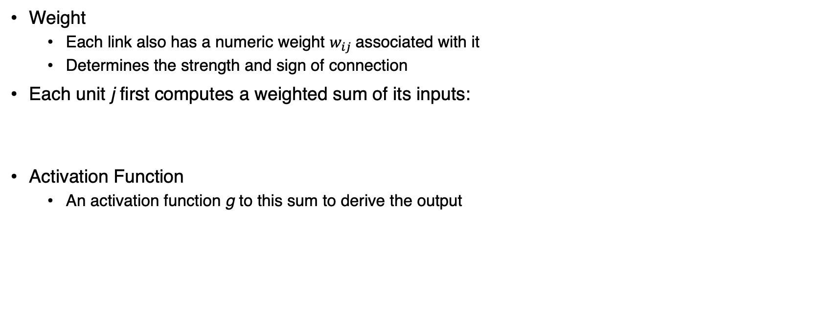
ANN building blocks
Weight
Each link also has a numeric weight $w_{ij}$associated with it
Determines the strength and sign of connection
Each unit j first computes a weighted sum of its inputs:
Activation Function
An activation function g to this sum to derive the output

Slide 9
ANN Activations
Threshold Activation
Linear single layer classifier
The activation function g is typically a hard threshold
Called a Perceptron
Logistic Function
Also referred to as Sigmoid perceptron
Both of these nonlinear activation function ensure the important property that the entire network of units can represent any nonlinear function
The logistic activation function has the added advantage of being differentiable

Slide 10
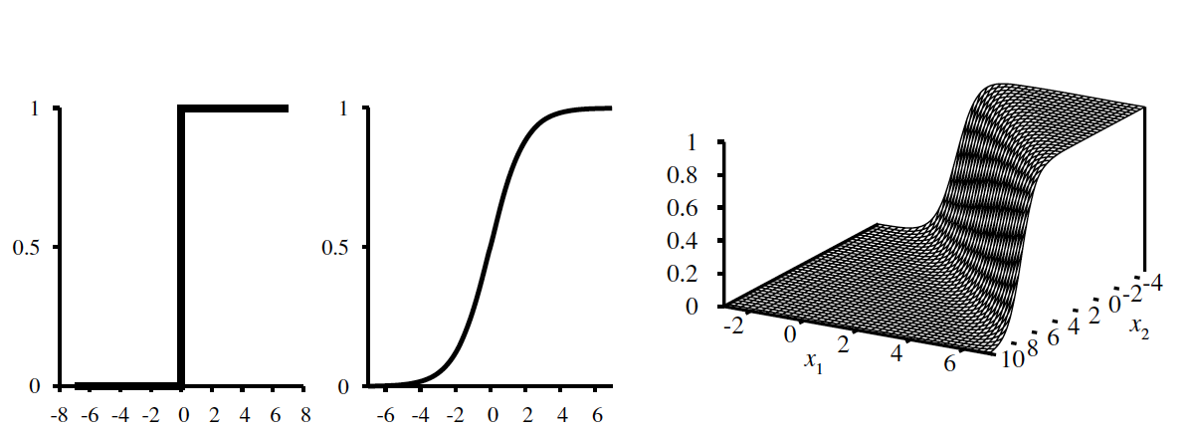
ANN Activations

Slide 11
ANN building blocks
Network of neurons:
Connecting the neurons together to form a network
Feed-Forward Network
A network that has connections only in one direction—that is, it forms a directed acyclic graph.
Every node receives input from “upstream” nodes and delivers output to “downstream” nodes; there are no loops
A feed-forward network represents a function of its current input; thus, it has no internal state other than the weights themselves

Slide 12
ANN building blocks
Layers
Feed-forward networks are usually arranged in layers, such that each unit receives input only from units in the immediately preceding layer
Hidden Units
One or more layers of units that are not connected to the outputs of the network

Slide 13
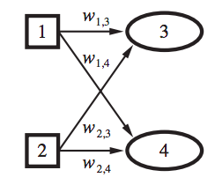
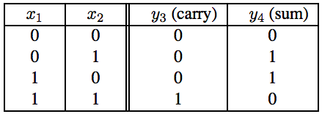
Single Layer Feed-Forward Neural Network
A network with all the inputs connected directly to the outputs
For Example
Consider addition of two binary digits
Two output units, one for sum and one for carry is needed
The perceptron network is as below Truth table of the network

Slide 14
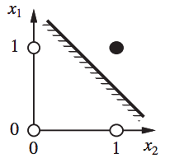
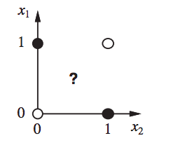
Perceptron Network
A perceptron network with m outputs is really m separate networks, because each weight affects only one of the outputs
So, there will be m separate training processes
Unit 3 Classifier Unit 4 Classifier

Slide 15
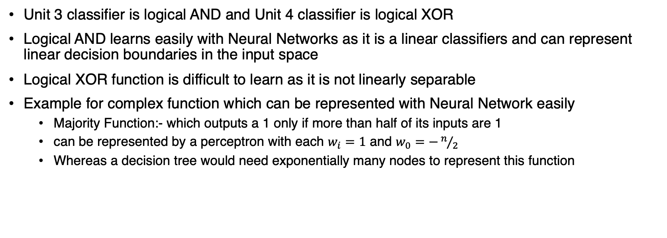
Perceptron Network
Unit 3 classifier is logical AND and Unit 4 classifier is logical XOR
Logical AND learns easily with Neural Networks as it is a linear classifiers and can represent linear decision boundaries in the input space
Logical XOR function is difficult to learn as it is not linearly separable
Example for complex function which can be represented with Neural Network easily
Majority Function:- which outputs a 1 only if more than half of its inputs are 1
can be represented by a perceptron with each $w_{i}=1$ and $w_{0}=−n/2$
Whereas a decision tree would need exponentially many nodes to represent this function

Slide 16
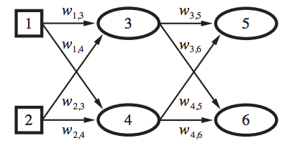
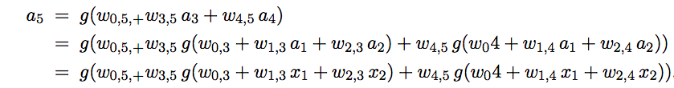
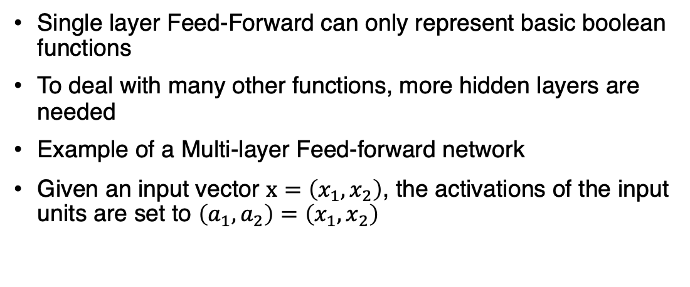
Multi-Layer Feed-forward Neural Network
Single layer Feed-Forward can only represent basic boolean functions
To deal with many other functions, more hidden layers are needed
Example of a Multi-layer Feed-forward network
Given an input vector $x=\left(x_{1},x_{2}\right)$, the activations of the input units are set to $\left(a_{1},a_{2}\right)=\left(x_{1},x_{2}\right)$

